Slide 1

Walmart Company
Michael Whitfield
FINCB/571
Professor Arnold Harvey
January 21, 2021

Slide 2

Key Performance Indicators
Walmart Inc. ticker symbol (WMT).
Revenues ($m) for 2019 $523,964.
Percentage change in revenue is +1.9%.
Profits ($m) $14,881.
Profits percentage change is +123.1%.
Revenue for 2020 ($m) was 524.
Notes:
Walmart Inc. which is indicated by the ticker timer (WMT) is a publicly traded company. The company seems to be doing well as it appears to have been listed as number one among the Fortune S&P 500 for the last eight years. In 2019, Walmart earned a revenue of 523,964 million US Dollars (Statista, 2020).

Slide 3
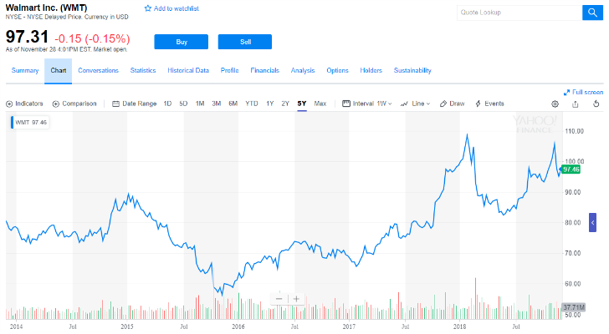
Key Performance Indicators
In 2020 - 19 Walmart EPS rose by 129.65% to $5.19
In 2019 – 18 it had declined by 31.1% to a $2.29 all time low.
Annual divided of $2.16 for 2020.
Annual divided of $2.08 for 2018.
Annual divided of $2.12 for 2019
Divided yield of 1.49% for 2020.
Notes:
Earnings per share for Walmart Inc. seems to have increased tremendously. It increased to $5.19 which was an increase of 129.65% from last year. For the last three consecutive years, 2018, 2019, and 2020 there has been realized an annual divided of 2.08, 2.12 and 2.16 which was increasing every single year. The company has had a divided yield of 1.49% for the year 2020.

Slide 4
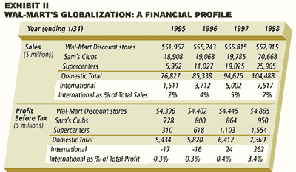
Key Performance Indicators
Growth estimates over the last five years per annum was 0.53%
Growth estimates for the next five years is expected to be 6.93% per annum.
Estimated revenue amount for the current quarter (Jan 2021) is $147.89 billion
Total revenue estimates for the whole years is $554.92 billion.
Notes:
According to data from yahoo finance, it is evident that growth estimated over the last five years was 0.53%. However, it is estimated that the company will expect an estimation growth rate of about 6.93% per annum (YahooFinance, 2020). In addition, it is expected that total revenue for the company will accumulate up to $554.92 billion.

Slide 5
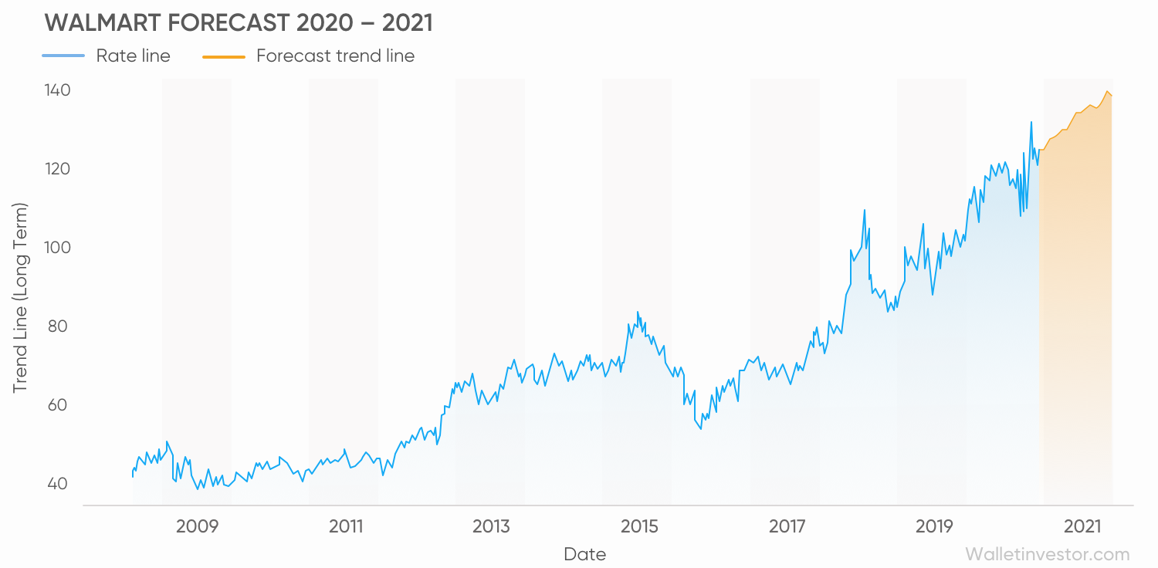
Key Performance Indicators
Net sales for the last three years:
$495.76 billion for 2018
$510.33 billion for 2019
$519.93 billion for 2020
Current Walmart Inc. stock price $143.39.
Stock price for the last 52 weeks was $144.20
Projected high stock price $165.00
Walmart Inc. shares are good to buy since the company appears to be doing well with its expected share price of $165.00 by the end of the next 52 weeks.
Notes:
Following the net sales recorded by Walmart in the last three years, it is evident that the company will continue to do well among the fortune companies. It earned a total of net sales $495.76 B, $510.00 B, and $519.93 B in 2018, 2019 and 2020 respectively (Statista, 2020). It is estimated that its stock price will increase from $143.39 to $165.00 by the end of the next 52 weeks. Therefore, it is okay to buy its shares.

Slide 6
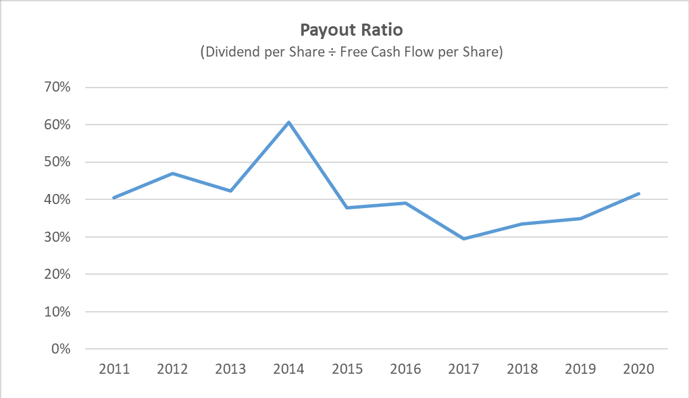
Stock Price to the Price-to-Earnings Ratio
Walmart’s price-to-earnings ratio is around23.88.
Stock price of Walmart Inc. is currently trading at $143.39.
Notes:
Walmart’s price-to-earning ratio was about 23.88 during last year (YahooFinance, 2020). This means that the company’s shares traded in the market at about twenty-four-times the earnings per share.

Slide 7
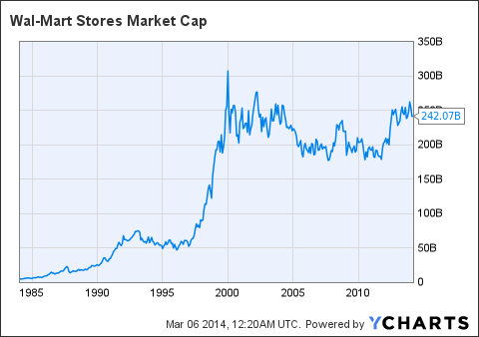
Market Capitalization
Market capitalization of Walmart Inc. in the last three years:
$269.85B
$335.99B
$406.54B by 12/21/2020
Current market cap as of January 19, 2021 is $409.23B
Notes:
Market cap or the market value is the most commonly used method of measuring the size of a publicly traded organization. It is calculated by taking the prevailing stock price and multiplying it with the number of outstanding shares. The market cap of the company seems to have improved over the last few days since the start of this year.

Slide 8
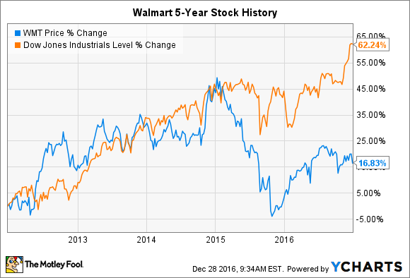
Trends Stock Price
Stock price as at Jan 20, 2021 is $143.59
Stock price as of Jan 08, 2021 was $146.88
Stock price as of Jan 04, 2021 was $144.30
Stock price as of Dec 31, 2020 was $144.20
Notes:
The price of the stock seems not to be differing that much. For instance, from Dec 31, 2020 up to Jan 04, 2020 the stock price recorded a difference of $0.10 and between Jan 08, 2021 to Jan 20, 2021 a difference of -3.29. The last change seems to be large.

Slide 9
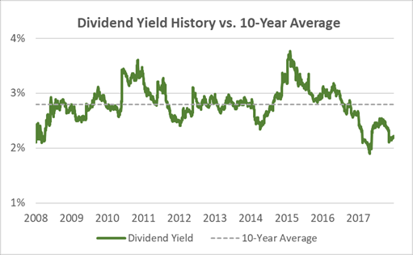
Trend in Divided Payout
Dividend payouts recorded by Walmart Inc. for the last few years is as follows:
Jan 31, 2016 $2.00
Jan 31, 2017 $2.04
Jan 31, 2018 $2.08
Jan 31, 2019 $2.12
Jan 31, 2021 $2.16
Notes:
The company’s trend of payout seems to be increasing over the last few years. This is an indication that the company has been improving over time; its profit earnings has improved over the stated years.

Slide 10

Trend in Total Shareholders’ Equity
Total Shareholders’ equity over the last few years is as follows:
Jan 31, 2020 $74,669M
Jan 31, 2019 $72,496M
Jan 31, 2018 $77,869M
Total shareholders’ equity might have not increased in Jan 31, 2020 due to the effects of Coronavirus.
This year the total shareholders’ equity might be lower as many companies have been affected negatively by the coronavirus.
Notes:
Total shareholders’ equity is the net worth of a business which is the amount that would be given back to the company’s shareholders if the business’s total assets were liquidated and all its debts repaid (Macrotrends, 2021). The company’s shareholders’ equity seems not to be stable over the last few years.

Slide 11
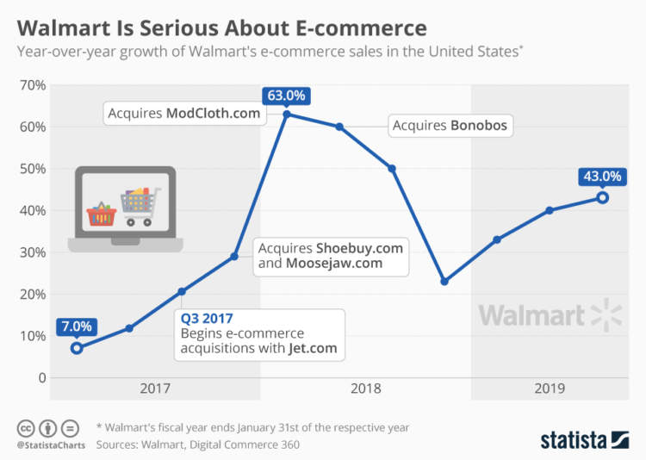
Recommendations
For those who already own Walmart’s stocks should just hold them.
For those who want to buy should buy the shares.
This is because of the following reasons:
Sales are consistently growing again.
Earnings are getting better.
The company seems to be embracing E-Commerce.
Notes:
For the shareholders who are already owing shares of Walmart should hold them since it has been projected that the price will shoot to close at $165.00 by the end of this year. Those who have not bought the shares, should buy as the company appears to be experiencing consistent sales growth. Also, the company has started to embrace e-commerce which might be the new norm with the pandemic assumed to persist into the few months or possibly years, although this will be unfortunate.

Slide 12
References
Macrotrends. (2021, January 20). Walmart EPS- Eranings per share 2006-2020. Retrieved from Retrived From: https://www.macrotrends.net/stocks/charts/WMT/walmart/eps-earnings-per-share-diluted
Statista. (2020, January 20). Walmart's Net Sales Worldwide from Fiscal year 2006 to 2020. Retrieved from Retrieved from: https://www.statista.com/statistics/183399/walmarts-net-sales-worldwide-since-2006/
YahooFinance. (2020, January 20). Walmart Inc. Retrieved from Retrieved from: https://finance.yahoo.com/quote/WMT/

